Slide 1


Computer Organization & Architecture
Chapter 4
Cache Memory

Slide 2
4.1 Overview of memory
Key characteristics of memory systems
  Location: Internal, External, Offline
  Capacity: word length, number of words
  Unit of transfer: word, block
  Access method: sequential, direct, random, associative
  Performance: access time, access cycle, bandwidth
  Physical type: semiconductor, magnetic, optical, magneto-optical
  Physical characteristics: volatile/nonvolatile, erasable/nonerasable
  Organisation: how to form bits to words

Slide 3
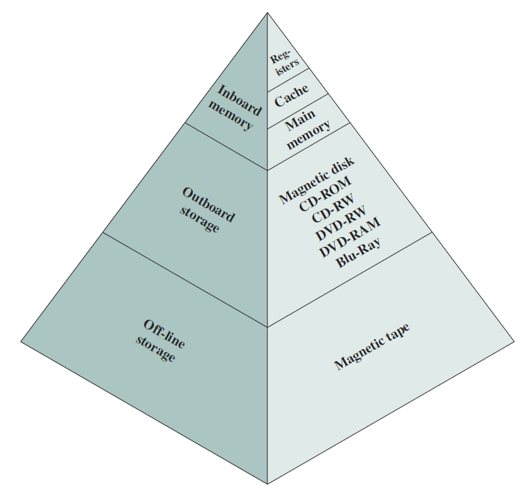
Ch.4-4.1
  Classification based on location：
      Internal motherboard, including inside CPU
      External motherboard
      offline

Slide 4
Ch.4-4.1
Capacity
  Word size
    Internal memory: in words or bytes. 8bit, 16bit,32bit;
    External memory: in bytes
  Number of words
    How many words or Bytes

Slide 5
Ch.4-4.1
Unit of Transfer
  Internal
    Usually governed by data bus width
  External
    Usually a block which is much larger than a word
  Addressable unit
    Smallest location which can be uniquely addressed
    Normally, it is word
    Allowing byte
    Address length & addressable unit：
N=2^{A}

Slide 6
Ch.4-4.2
word Address Binary word Address Binary Byte Address Byte Address
0 000
1 001
2 010
3 011
4 100
5 101
6 110
7 111
000 0
000 1
001 0
001 1
010 0
010 1
011 0
011 1
100 0
100 1
101 0
101 1
110 0
110 1
111 0
111 1
0
1
2
3
4
5
6
7
8
9
10
11
12
13
14
15
A block = 2 words

Slide 7
Ch.4-4.2
word Address Binary word Address Binary Byte Address Byte Address
0 00
1 01
2 10
3 11
00 00
00 01
00 10
00 11
01 00
01 01
01 10
01 11
10 00
10 01
10 10
10 11
11 00
11 01
11 10
11 11
0
1
2
3
4
5
6
7
8
9
10
11
12
13
14
15
A block = 4 words

Slide 8
Ch.4-4.1
Access Methods
  Sequential
    Start at the beginning and read through in order
    Access time depends on location of data and previous location
    e.g. tape
  Direct
    Individual blocks have unique address
    Access is by jumping to vicinity plus sequential search
    Access time depends on location and previous location
    e.g. disk, optic disk

Slide 9
Ch.4-4.1
  Random: address-based access
    Individual addresses identify locations exactly
    Access time is independent of location or previous access
    e.g. DRAM
  Associative: comparing part of content to access, a kind of random access
    Data is located by a comparison with contents of a portion of address for all the words
    Access time is independent of location or previous access
    e.g. cache

Slide 10

Ch.4-4.1
Performance Factors of Memory
  Access time: the time of getting data out of memory. Different memory has different access time.
    For random access memory, access time is from the instant the address presented to memory to the instant of the data on the bus.
  Memory cycle time: access time + additional time before a second access
    Used for random access memory
  Transfer rate R: data transferred into or out of a memory unit per second
    1/ Memory cycle (for random access memory)
    (for non-random access memory)

Slide 11
Ch.4-4.1
Physical Types (material)
  Semiconductor (LSI/VLSI)
    RAM, ROM
  Magnetic
    Disk & Tape, mobile hard-disk
  Optical
    CD & DVD

Slide 12
Ch.4-4.1
Physical Characteristics
  volatile/nonvolatile
  Erasable or not (ROM/EPROM)
  Power consumption

Slide 13
Ch.4-4.1
Memory Hierarchy
  For memory，the questions we concern are:
    Capacity
    Velocity
    Price
  Relationship
    Velocity Price
    Capacity Price Capacity Velocity
    Capacity Velocity Price
  Solutions: Memory Hierarchy
?

Slide 14
Ch.4-4.1
Memory Hierarchy
Cache
Main memory
External memory

Slide 15
Ch.4-4.1
Locality of Reference
  Principle of locality of reference: during the course of program execution, CPU accesses instructions or data in cluster.
  Because:
    Programs typically contain many loops and subroutines -- repeated references；
    Table and array involve access to clustered data set -- repeated references
    Programs or data are always put in sequence, instructions or data to be accessed are typically nearby current instruction or data.

Slide 16
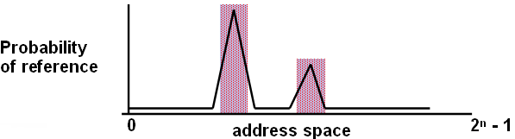
Ch.4-4.1
A Rule of Thumb/Principle of Locality:
  90/10 rule: 10% of code executed 90% of time
Two types of locality:
  Temporal locality: if an item is referenced, it will tend to be referenced again soon
  Spatial locality: if an item is referenced, items whose addresses are close by tend to be referenced soon

Slide 17
Ch.4-4.1
Multi-level Memory Techniques
  According to locality of reference and the fact that the lower memory is used more infrequent, memory can be designed into multi-level structure.
    Introduce one or more levels of caches between CPU and memory
CPU
Caches
Memory

Slide 18
Ch.4-4.1
Example
In above figure, suppose capacity of cache is 1000 words, access time is 0.1μs (T₁)；capacity of memory is 100 thousands words, its access time is 1μs (T₂). Suppose in the program execution, 95% (H) words can be accessed from the Cache, then, the time of access a word form this memory system is:
0.95*0.1+(1-0.95)*(1+0.1)=0.15 (μs)
Conclusion：
  0.15<<1, access time is reduced greatly
  Large capacity
  Low price (close to the price of memory)

Slide 19
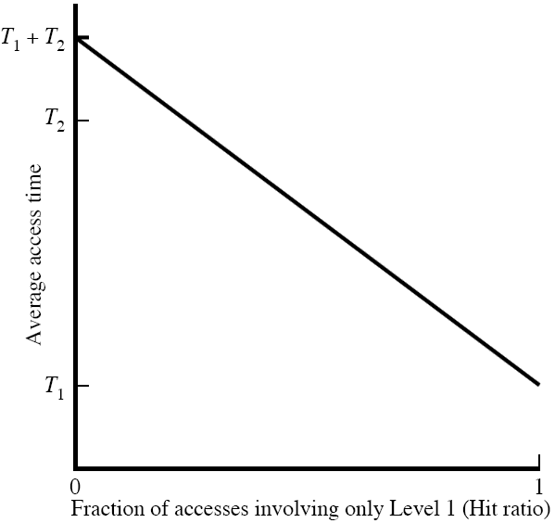
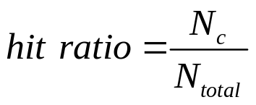

Ch.4-4.1
Performance of a Simple Two-Level Memory
memory data found in the upper level such as cache, it is called Hit; otherwise called miss
N_{c} ---hit times of level 1 memory
N_{m} --- total access times of memory

Slide 20
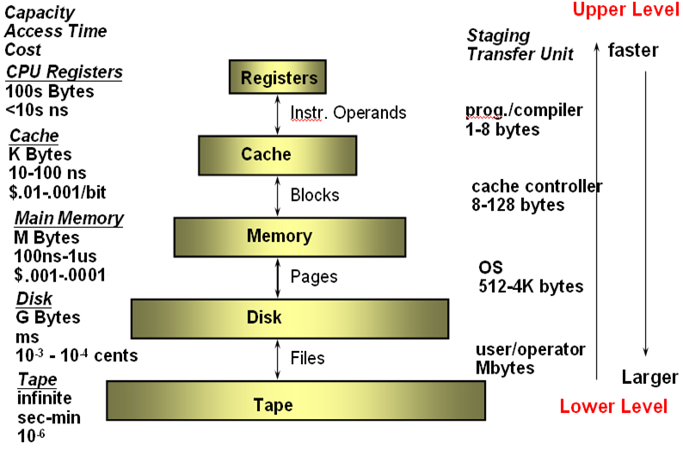
Ch.4-4.1
Levels of Memory Hierarchy
Semiconductor

Slide 21

4.2 Cache memory principles
Cache
  Small amount of fast memory
  Sits between normal main memory and CPU
  May be located on CPU chip or module

Slide 22
Ch.4-4.2
Cache memory is a critical component of the memory hierarchy
  Compared to the size of main memory, cache is relatively small
  Operates at or near the speed of the processor
  Very expensive compared to main memory
  Cache contains copies of sections of main memory

Slide 23
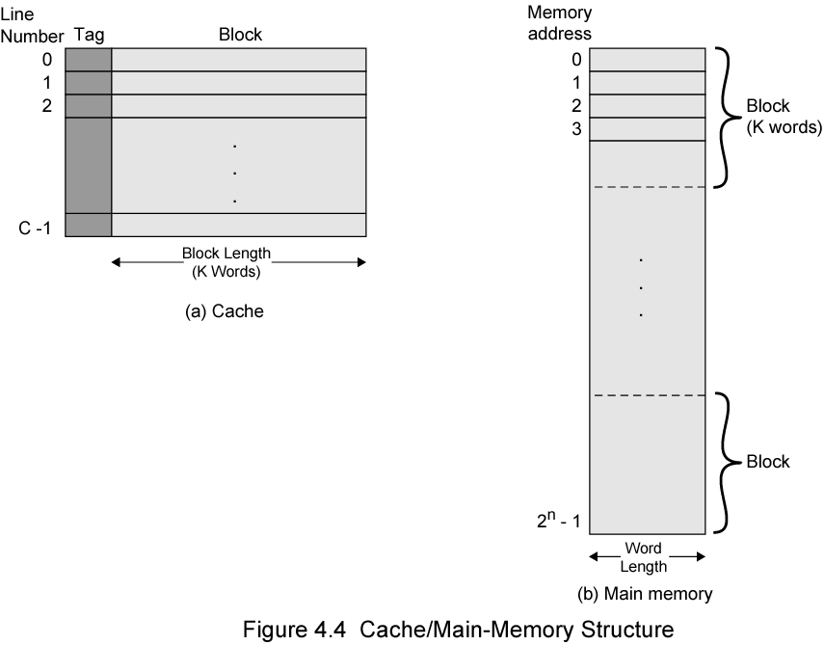
Ch.4-4.2
Block number is the high bits
of the word address
Cache/Main Memory Structure
M

Slide 24
Ch.4-4.2
Specification for figure 4.4
  Main memory contains 2^{n} words/units，K words consist of a block
    Total blocks: M= 2^{n} /K
  Cache contains C lines, a line contains K memory words
    A cache line = a memory block
  C<<M
  At any time, at most C blocks can reside in the Cache
    A line can not be occupied by a fixed block
  Each line has a tag to identify which block of memory
    Many memory blocks can mapped into a cache line

Slide 25
Ch.4-4.2
Block number Binary block number Word Address
0 000
1 001
2 010
3 011
4 100
5 101
6 110
7 111
000 0
000 1
001 0
001 1
010 0
010 1
011 0
011 1
100 0
100 1
101 0
101 1
110 0
110 1
111 0
111 1
A block = 2 words

Slide 26
Ch.4-4.2
Block number Binary block number Word Address
0 00
1 01
2 10
3 11
00 00
00 01
00 10
00 11
01 00
01 01
01 10
01 11
10 00
10 01
10 10
10 11
11 00
11 01
11 10
11 11
A block = 4 words

Slide 27
Ch.4-4.2
Cache operation – overview
  Part contents of main memory are also in Cache
  CPU requests contents of memory location
  Check cache for this data
  If present, get from cache (fast)
  If not present, read required block from main memory to cache
  And deliver the word to CPU
  Cache includes tags to identify which block of main memory is in each cache slot

Slide 28
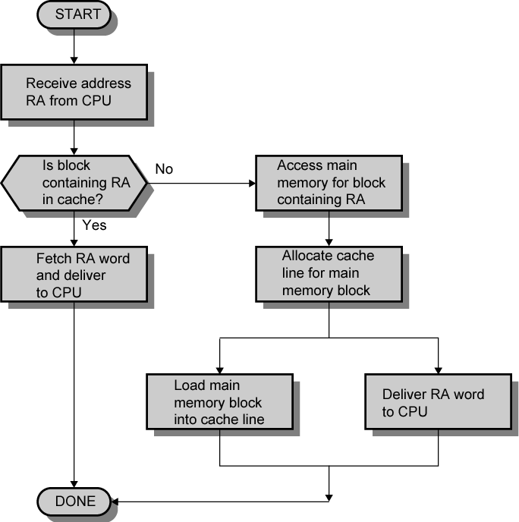
Ch.4-4.2
Cache Read Operation - Flowchart

Slide 29

Ch.4-4.2
Typical Cache Organization

Slide 30
4.3 Cache Design
Key Techniques in Cache Design
  Size
  Mapping Function
  Replacement Algorithm
  Write Policy
  Block Size
  Number of Caches
  Address of Cache

Slide 31
Ch.4-4.3
Cache Size Selection
  Small size
    Cheap: Cache-Memory price is close to the price of main memory
    Low hit, access speed may be slower than accessing main memory
  Large size
    High hit: close to 100%, access speed may be close to Cache access
    costly
    More Gates, slightly slower than small cache
    Large CPU area occupation
  Trade-off between capacity, price and speed
  No optimum cache size, 1K~512K words are all effective

Slide 32
Ch.4-4.3
Mapping function
  C<<M
  Mapping mechanism needed
    Mapping memory block to cache line
    Which memory block occupies which cache line
  Mapping function is implemented in hardware
    Mapping function determines cache structure
  Typical mapping functions：
    Direct Mapping
    Associative Mapping
    Set Associative Mapping

Slide 33
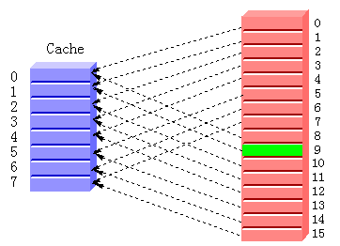
Ch.4-4.3
Direct Mapping
  The simplest mapping, block → fixed line
  Each main memory block is assigned to a specific line in the cache:
i = j modulo m
  where i is the cache line number assigned to main memory block j, m is the number of lines in the cache
block

Slide 34


Ch.4-4.3
Cache line Main Memory blocks held
0 0, m, 2m, 3m…2^{s}-m
1 1, m+1, 2m+1…2^{s}-m+1
m-1 m-1, 2m-1, 3m-1…2^{s}-1
m=2, 2^{s}=8
Block number Binary block number Cache line number
0 00 0 0
1 00 1 1
2 01 0 0
3 01 1 1
4 10 0 0
5 10 1 1
6 11 0 0
7 11 1 1

Slide 35
Ch.4-4.3
m=4, 2^{s}=16
Block num. Binary block num. Cache line num. Binary Cache line num.
0 00 00 0 00
1 00 01 1 01
2 00 10 2 10
3 00 11 3 11
4 01 00 0 00
5 01 01 1 01
6 01 10 2 10
7 01 11 3 11
…….
15 11 11 3 11
Blocks whose low bits of block num. are same should map the same cache line

Slide 36
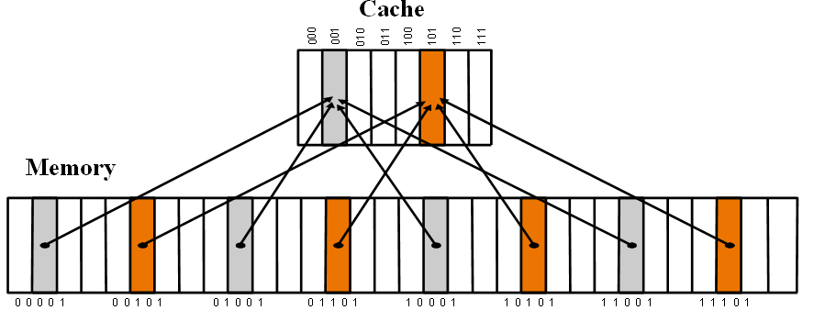
block number

Slide 37

Ch.4-4.3
Implement for Direct Mapping
  Given an address, how to read Cache?
    Which Cache line?
    Which word?
  Method: memory address separated into 3 parts:
    Low w bits identify content/word
    Middle r bits identify Cache line
    Left bits identify whether the data is needed
      Tag identify which memory block
word address

Slide 38
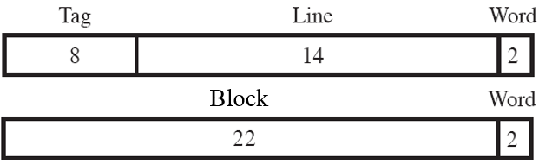
Ch.4-4.3
word address
Example
word address: 16339C
0001 0110 0011 0011 1001 1100
block number: 058CE7
00 0101 1000 1100 1110 0111
line number: 0CE7
00 1100 1110 0111
tag: 0001 0110 16

Slide 39
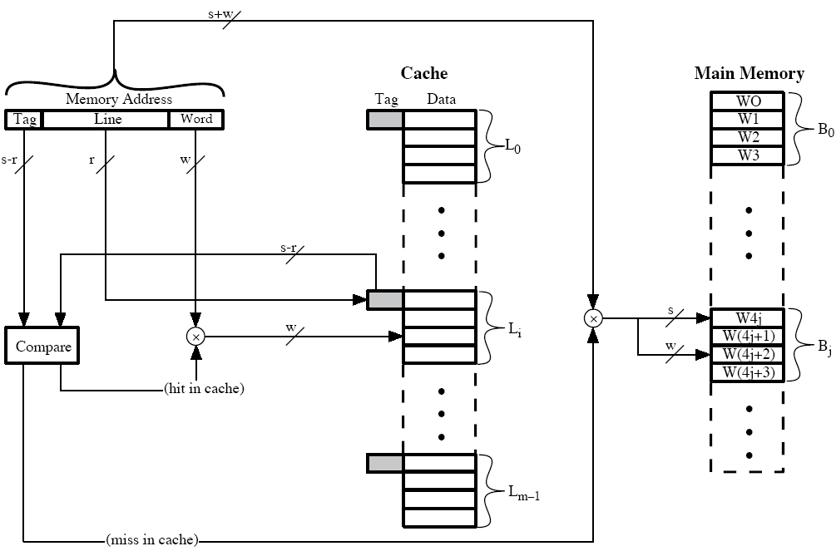
Ch.4-4.3
Direct Mapping Cache Organization
word address
block num.

Slide 40
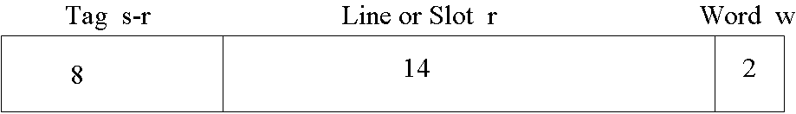
Ch.4-4.3
Direct Mapping Address Structure
  24 bit address
  2 bit word identifier (4 byte block)
  22 bit block identifier
    8 bit tag (=22-14)
    14 bit slot or line
  No two blocks in the same line have the same Tag field
  Check contents of cache by finding line and checking Tag

Slide 41
For all three cases, the example includes the following elements:
  The cache can hold 64KB;
  The cache in blocks of 4 words with 4B each. This means that the cache is organized as 16K=2¹⁴ line of 4B each;
  The main memory consists of 16MB, which each byte directly addressable by a 24-bit address (2²⁴=16M). We can know main memory consist of 4M blocks of 4B each

Slide 42
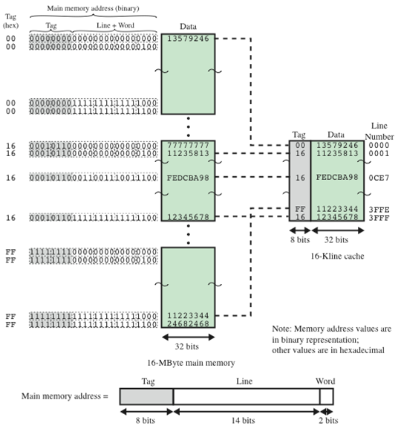
Ch.4-4.3
Direct Mapping Example
Notes:
1 Cache: m=2¹⁴ lines, 4 words/line
2 Main memory: 16MB
3 2⁸ different block can be put into a line
word address
16339C

Slide 43
Ch.4-4.3
Direct Mapping Summary
  Address length = (s + w) bits
  Number of addressable units = 2^{s+w} words or bytes
  Block size = line size = 2^{w}words or bytes
  Number of blocks in main memory = 2^{s+w}/2^{w} = 2^{s}
  Number of lines in cache = m = 2^{r}
  Size of tag = (s – r) bits

Slide 44
Ch.4-4.3
Direct Mapping pros & cons
  Simple
  Inexpensive to implement
  Fixed location for given block
    If a program accesses 2 blocks that map to the same line repeatedly, cache misses are very high
    ---thrashing

Slide 45
I1： data1
I2： data2
I3： data3
I4： data4
data1
data2
data3
data4

Slide 46
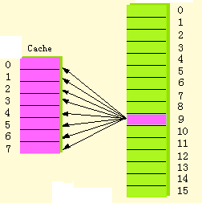
Ch.4-4.3
Fully Associative Mapping
  A main memory block can load into any line of cache
    Block and line have no fixed mapping relationship
  Memory address = tag + word
  Tag uniquely identifies block of memory
  Every line’s tag is examined for a match

Slide 47

Ch.4-4.3
Fully Associative Cache Organization
word address
block num.

Slide 48
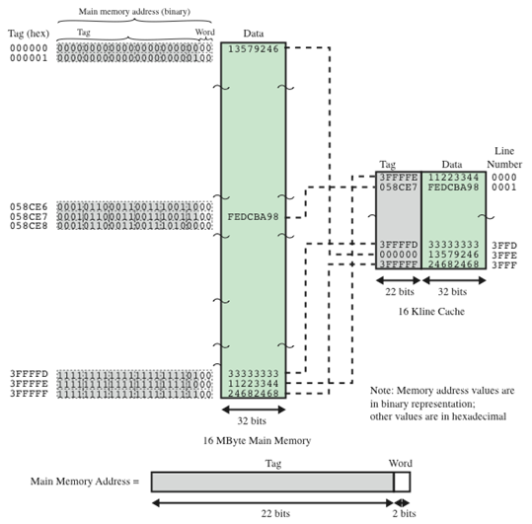
Ch.4-4.3
Associative Mapping Example
word address
16339C

Slide 49

Ch.4-4.3
Associative Mapping Address Structure
  22 bit tag stored with each 32 bit block of data
  Compare tag field with tag entry in cache to check for hit
  Least significant 2 bits of address identify which 8 bit data is required from 32 bit data block
  e.g.
    Address Tag Data Cache line
    FFFFFC 3FFFFF 24 3FFF

Slide 50
Ch.4-4.3
Associative Mapping Summary
  Address length = (s + w) bits
  Number of addressable units = 2^{s+w} words or bytes
  Block size = line size = 2^{w} words or bytes
  Number of blocks in main memory = 2^{s+w}/2^{w} = 2^{s}
  Number of lines in cache = undetermined
  Size of tag = s bits

Slide 51
Ch.4-4.3
Fully Associative Mapping pros & cons
  pros:
    A memory block can be mapped into any line of the cache
    Replacing is flexible
  cons :
    Parallel comparing circuit is needed
    Complex and expensive

Slide 52
Ch.4-4.3
Set Associative Mapping
  Divide cache and memory into sets, each set includes lots of lines.
  Direct mapping for cache set and memory set; Full associative mapping between two sets
  Set associative mapping=direct mapping + Full associative mapping
  A cache of m lines is divided into v sets, k lines/set, then
    m=v x k
    Set number of Cache i = block number of memory mod v
  A given block may map to any line in a given set

Slide 53
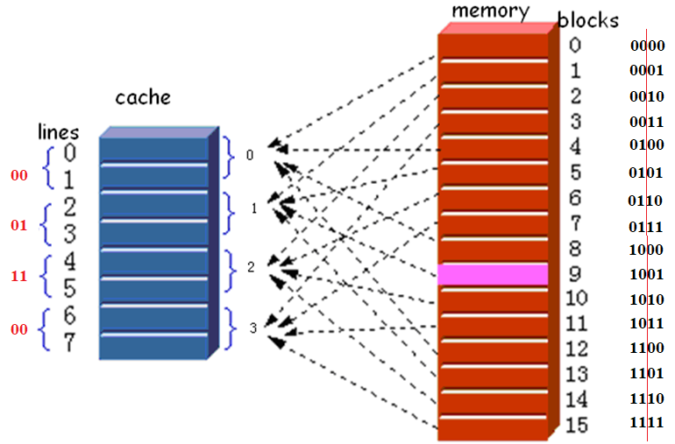
Set Associative Mapping

Slide 54
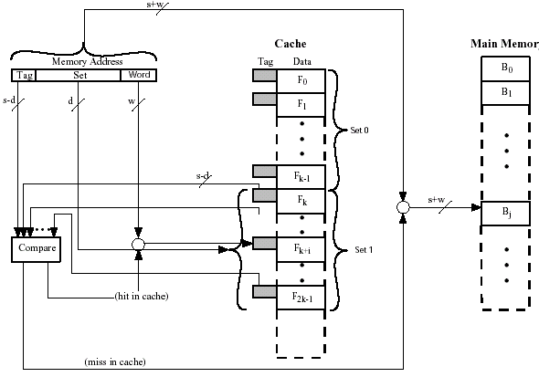
Ch.4-4.3
K Way Set Associative Cache Organization
word address
Block number mod v=0
block num.

Slide 55
Ch.4-4.3
Set Associative Mapping Example
  12 bit set number
  Block number in main memory is modulo 2¹²
  Block 000000, 00A000, 00B000, 00C000 … map to same set

Slide 56

Ch.4-4.3
Set Associative Mapping Address Structure
  Use set field to determine cache set to look in
  Compare tag field to see if we have a hit
  e.g
    Address Tag Data Set number
    FFFFFC=1FF 7FFC 1FF 12 1FFF
    00FFFC=001 7FFC 001 11 1FFF
  tag+set number → a block of memory number
  In a set, the tag of block is exclusive: there is no same tag in a set
  For m=v x k，
    k=1，direct mapping
    v=1，associative mapping

Slide 57
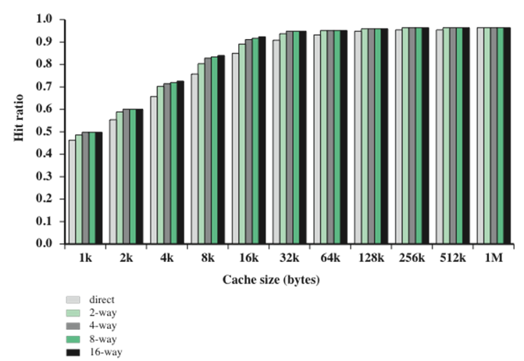
Varying Associativity Over Cache Size
  2-way set associative mapping is in common use
  4-way set associative makes a modest additional improvement for a relatively small additional cost

Slide 58
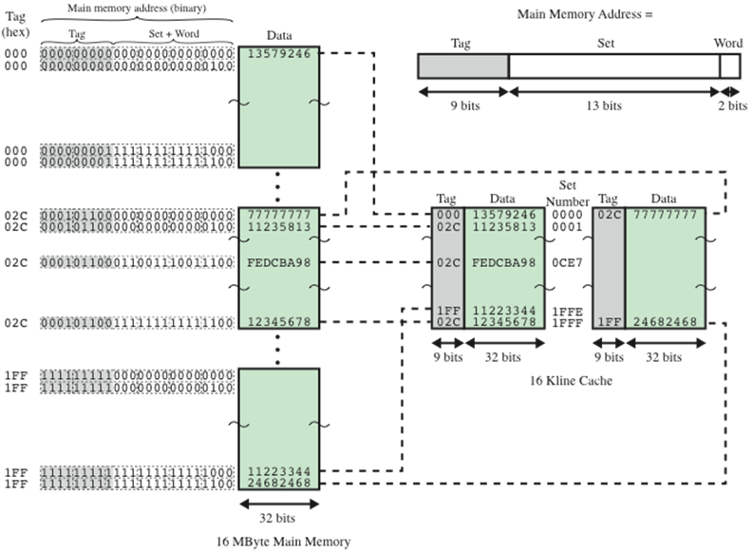
Ch.4-4.3
02c
word address
160004
16339C
Set Associative Mapping Example

Slide 59
Ch.4-4.3
Set Associative Mapping Summary
  Address length = (s + w) bits
  Number of addressable units = 2^{s+w} words or bytes
  Block size = line size = 2^{w} words or bytes
  Number of blocks in main memory = 2^{s}
  Number of lines in set = k
  Number of sets = v = 2^{d}
  Number of lines in cache = kv = k x 2^{d}
  Size of tag = (s – d) bits

Slide 60
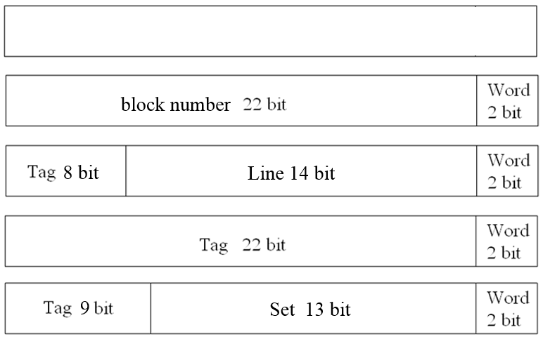
Ch.4-4.3
Address Structures of Three Mapping function techniques
word address
direct
Fully
association
set
association
tagfull > tagset>tagdirect
Hdirect<Hset<Hfull

Slide 61
Ch.4-4.3
An example
Suppose a computer, its main memory is 4MB，Cache’s capacity is 16KB，block size is 8 words，word length is 32bit，addressed by word, please design a cache organization of 4-way set associative mapping, require:
  1 draw the structure of main memory address and mark the bits of each segment；
  2 initially, Cache is empty，CPU fetches 100 words from memory unit0, unit1, … unit99 in sequence, repeat this sequence 8 times. How much is the hit rate of Cache ？
  3 if the speed of cache is 6 time that of main memory, introducing cache, how many times is the speed of CPU accessing memory improved？

Slide 62
CPU fetches 100 words from memory unit0, unit1, … unit99
0 ⅹ 0- 7->Cache (set 0) 1V2V3V4V5V6V7V
8 ⅹ 8-15->Cache (set 1) 9V10V11V12V13V14V15V
16ⅹ 16-23->Cache (set 2) 17V18V19V20V21V22V23V
24ⅹ 24-31->Cache (set 3) 25V26V27V28V29V30V31V
32ⅹ 32-39->Cache (set 4) 33V34V35V36V37V38V39V
40ⅹ 40-47->Cache (set 5) 41V42V43V44V45V46V47V
48ⅹ 48-55->Cache (set 6) 49V50V51V52V53V54V55V
56ⅹ 56-63->Cache (set 7) 57V58V59V60V61V62V63V
64ⅹ 64-71->Cache (set 8) 65V66V67V68V69V70V71V
72ⅹ 72-79->Cache (set 9) 73V74V75V76V77V78V79V
80ⅹ 80-87->Cache (set 10) 81V82V83V84V85V86V87V
88ⅹ 88-95->Cache (set 11) 89V90V91V92V93V94V95V
96ⅹ 96-103->Cache (set 12) 97V98V99V100 101 102 103
13 times miss

Slide 63

Ch.4-4.3
Solutions
  First step: obtain address length
    4MB/4B=1M→address length=20bit
  Second step: obtain Cache lines(blocks) and sets
    Word address length=log₂8=3 bits
    16KB/(8×4B)=0.5K=2⁹(lines)
    4-way set associative means 4lines/set,
      2⁹/4=2⁷(sets)→set address length=7 bit
  Third step: draw Fig. of word segment
  2) (87+700)/800=98%
  3) suppose time of accessing cache is t, then time of accessing memory is 6t.
    6t/(98% ×t+2% ×7t)=5.3(times)
Tag set word

Slide 64
Ch.4-4.3
Replacement Algorithms (1)
--- Direct mapping
  No choice
  Each block only maps to one line（fixed）
  Replace that line

Slide 65
Ch.4-4.3
Replacement Algorithms (2)
--- Associative & Set Associative
  Hardware implemented algorithm (speed)
  Least Recently used (LRU)：use=1/0 as mark bit
    e.g. in 2 way set associative
      Which of the 2 block is lru?
  First in first out (FIFO)
    replace block that has been in cache longest
  Least frequently used
    replace block which has had fewest hits
  Random：performance is almost the same as LRU
  Optimized ：replace the line accessing in the farthest future

Slide 66
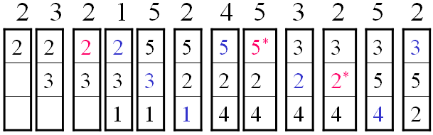
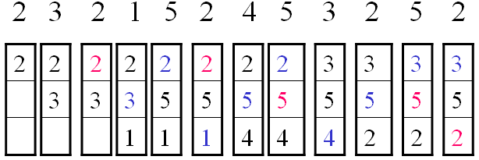
Ch.4-4.3
Examples
  1
  FIFO:
    Hit times: 3
  2
  LRU:
    Hit times: 5

Slide 67
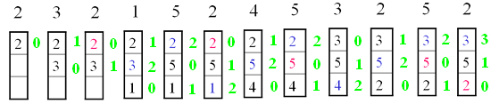

Slide 68
Ch.4-4.3
Write Policies
  Different from read, Cache write is more complex
    Data consistency between Cache, Memory and other Caches
  Two Cache write policies used usually for single CPU system:
    Write through
    Write back

Slide 69
Ch.4-4.3
Write through
  Def.: write memory while writing Cache
    All writes go to main memory as well as cache
  disadvantages：
    Lots of writing traffic，may result in bus bottleneck
    Slows down writes

Slide 70
Ch.4-4.3
Write back
  Write back：not only write Cache, but also modified flag is put in the written line, and when the line is replaced, write back that line to memory
    Updates initially made in cache only
    Update bit for cache slot is set when update occurs
    If block is to be replaced, write to main memory only if update bit is set
  Suitable for iterative operation and the system that I/O module is directly connected to Cache
  disadvantages：
    Part of contents in the memory is invalid
    Circuit is complex
    Cache may become bottleneck

Slide 71
Ch.4-4.3
Cache coherency methods
--- multiple CPU
  Bus watching with write through
    Cache controller monitors address lines, if a location is written in the shared memory and the data is in the cache, invalidate the cache entry.
  Hard Transparency
    Additional hardware is used . When a cache writes memory, corresponding entry in other caches is also updated
  Noncachable Memory
    Many CPU share a potion of main memory, shared contents are never copied into caches

Slide 72
Ch.4-4.3
Cache line size vs. hit rate
  Principle of locality: the data in the vicinity of referenced word are likely used in the near future
    Block transferred
  To some extent, increasing line size will result in hit rate increase
  But, if the line is too large, hit ratio will become decrease
    Replace by a line, cost of replace becomes higher
    Probability using new data is less than that of using replaced data
  Line size vs hit ratio is decided by local characteristic of program.
    No optimum
    Normally, 8~32B

Slide 73
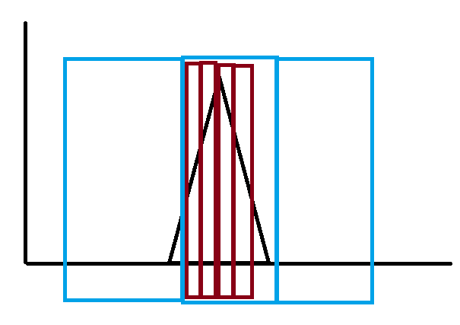
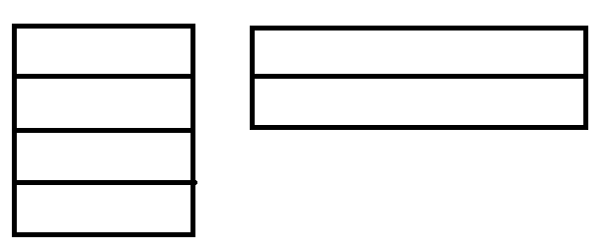

Slide 74
Ch.4-4.3
Number of Caches
  Single cache vs multilevel Cache
    On-chip Cache（L1）：short path to CPU, fast speed and reduce the frequency of bus access
    Off-chip Cache（L2）：only L1 access miss results in accessing L2
  Unified Cache and Split Cache
    Unified Cache:
      Storing Data & instruction, balancing load automatically
      Hit rate high
    Split Cache:
      Data Cache & instruction Cache
      Parallel operation

Slide 75
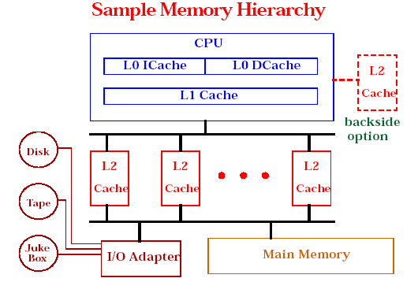
Ch.4-4.3

Slide 76
Ch.4-4.3
Cache Organization of Pentium 4
  Cache evolving in Intel CPU
    80386： no on-chip cache
    80486： 8KB,4 way set associative ,line size=16B
    Pentium：two 8KB on-chip Cache，2 way set associative, line size=32B
    Pentium4 ：
      Two L1
        12K μops
        8KB, 4 way set associative , line size=64B –data cache
      One L2
        256K~1MB, 8 way set associative , line size=128B, Feeding both L1 caches
      L3 cache on chip
  LRU & write back policy

Slide 77
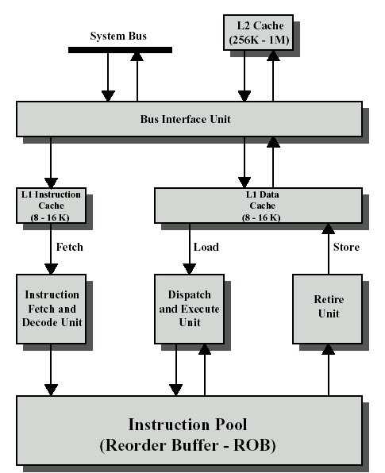
Ch.4-4.4
Block Diagram of PentiumⅡ

Slide 78
Vocabulary
DRAM(Dynamic random-access memory):动态随机存取（访问）存储器
ZIP Cartridge: ZIP活动磁盘
Controller：控制器
Capacity:容量
Unit of transfer：传送单元
Addressable unit：可寻址单元
Sequential access：顺序访问
Associative access: 关联访问
Nonvolatile memory:恒态存储器

Slide 79
Vocabulary
WORM(write once read many):一写多读存储器
MO(magneto-optical disk):磁光盘
Set associative mapping：组关联映射
Replacement Algorithm:替换算法
FIFO(first-in- first- out)：先进先出
LRU(least frequently used)：最近最少使用
Write through：写直达
Retire unit：回收单元
Consistency：一致性
Coherency：一致性

Slide 80
Key points
  How about Memory Hierarchy? What executes it according to?
  Where can block be placed in cache?
  How is block found in cache?
  Which block is replaced on miss in cache?
  How about writes policy in cache?

Slide 81
Exercises
Pp. 169. problem 4.1-4.4
For the address sequence: 1 2 3 4 1 2 3 4 1 2 3 4, draw and compute the hit ratio of 3-line cache using FIFO & LRU; which methods can be used to improve the hit ratio?
Consider a machine with Cache-main memory system structure. Its main memory has 8 blocks(0-7) which block size is 4 words, and its Cache has 4 lines(0-3) and adapts a organization of 2-way set associative with LRU replacement algorithm, require:
1) show the structure of main memory address
2) show the corresponding relationship of main memory block number and Cache line number
3) Supposed initial Cache status is empty, for the address sequence: 1，2，4，1，3，7，0，1，2，5，4，6，4，7，2，list the assigned addresses of cache lines after each visit.
4) Given the hit ratio of Cache after above steps.

Slide 82
3.3 Hint：
  32-bit microprocessor＝数据总线32位，一次寻址可以得到一个32位数据，且用于寻址的只能是24位
  指令也是一种数据必须要能一次寻址得到，所以2²⁴×32bit＝2²⁴×4byte=64MB
  32位的局部地址线，一次就指定一条指令，但需要两次16位局部数据总线传输才可取到该指令；
  16位的局部地址线，两次传输才可指定一条指令，同样需要两次16位局部数据总线传输才可取到该指令；
  那第一问第二问应该就解决了；
  PC就是存指令地址的，每一个可能用到的指令都要占一位，指令码后数据不同都要另外算一个指令地址，那总共需要多数呢，地址刚刚说多少位呢，那PC最少多少位？IR本身就是存指令的那么，指令是32位，IR多少位。但另一般PC位＝IR位

